Slide 1
My motivation
By: Yashkumar Shah

Slide 2
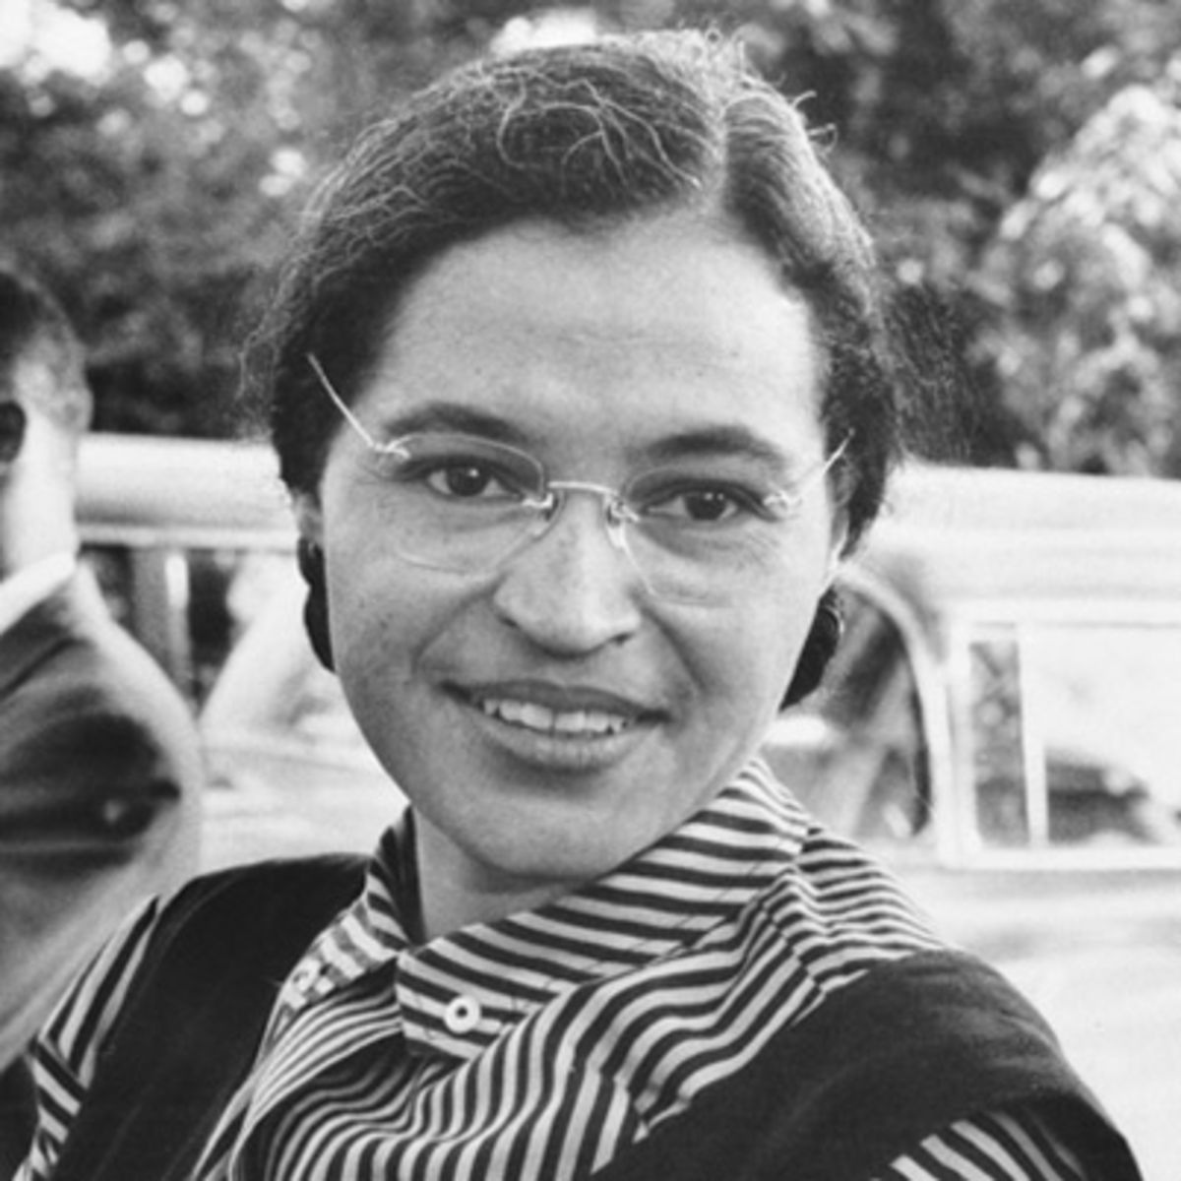
Rosa parks

Slide 3
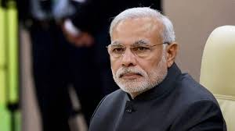
Narendra Modi

Slide 4
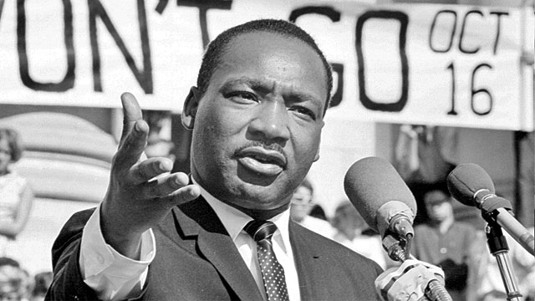
Martin Luther King

